Slide 1
Videos to queue up
Supreme Commander 2
https://www.youtube.com/watch?v=iHuFCnYnP9A
Conway’s Game of Life
https://www.youtube.com/watch?v=C2vgICfQawE
Lion King Wildebeest Stampede
https://www.youtube.com/watch?v=FbLA0LS67XE
Stanley and Stella in Breaking the Ice
https://www.youtube.com/watch?v=aYEp26g14Wk
Starling Swarm
https://www.youtube.com/watch?v=DmO4Ellgmd0
https://www.red3d.com/cwr/steer/ (Install “CheerpJ” Applet Runner for Chrome to view)

Slide 2
Artificial Intelligence for Games Week 4 – Movement 2 Steve Rabin
For help on projects, email everyone (select and copy this string from the start of any class PowerPoint):
steve.rabin@gmail.com, p.jiankai@digipen.edu, b.hsu@digipen.edu, zak.s@digipen.edu, keaton.sullivan@digipen.edu, john.tseng@digipen.edu, a.roulst@digipen.edu
TAs: Jian Kai Phua, Brandon Hsu, Zak Stephenson, Keaton Sullivan, John Tseng, Andrew Roulst

Slide 3
Questions
Name as many steering behaviors as you can.
Which steering behavior converts uniform randomness into smooth randomness?
What were the steering behavior rules for the follow the leader example? (ducklings version)
Flow fields work best in what kind of environments?
Name as many ways as you can think of to generate the vectors in a flow field.
What does group emergent behavior emerge from?

Slide 4
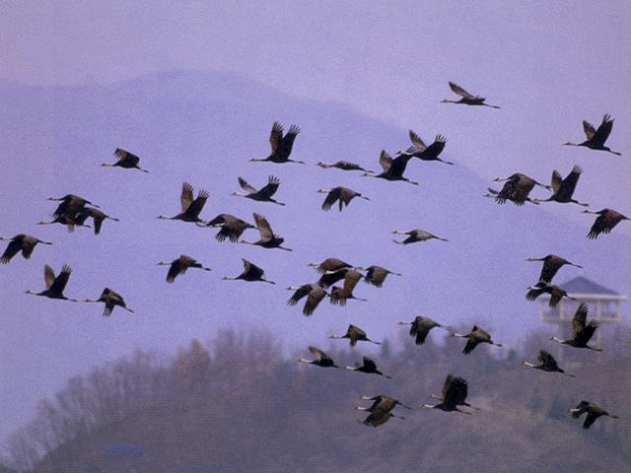
Flocking

Slide 5
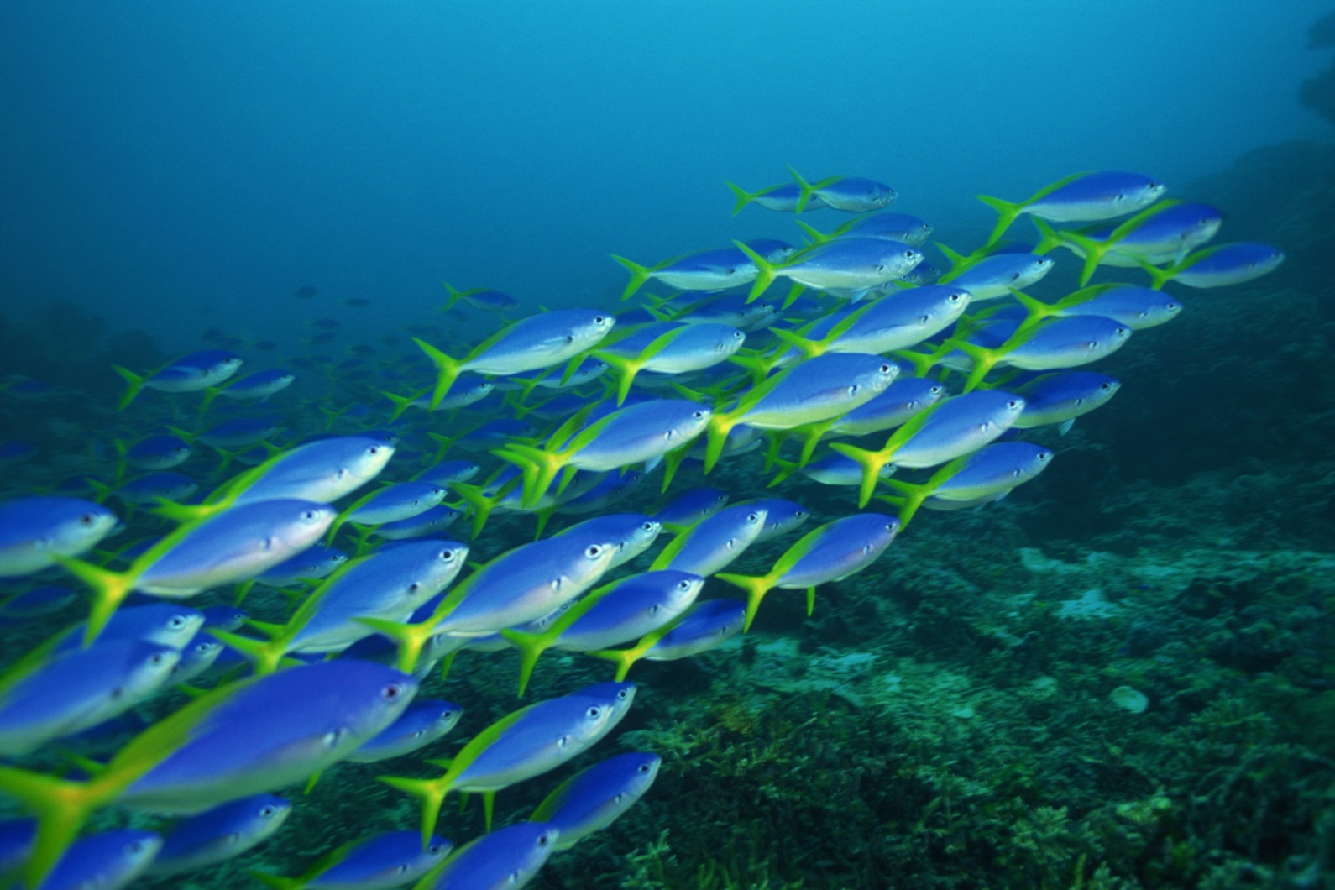
Flocking

Slide 6
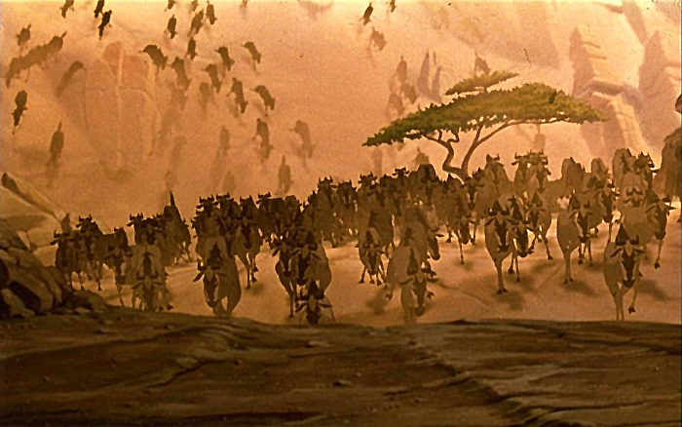
Flocking

Slide 7
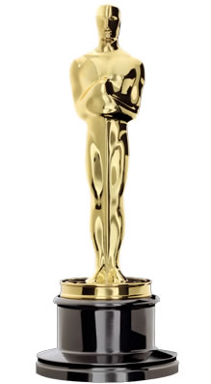

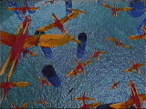
Flocking
First demonstrated by Craig Reynolds in his 1987 SIGGRAPH paper and movie
“Flocks, Herds, and Schools: A Distributed Behavior Model”
Film: “Stanley and Stella in Breaking the Ice"
1997
Scientific and Technical Award

Slide 8
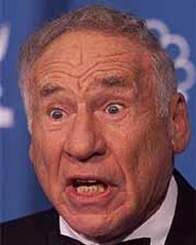
Boids
“The name had three influences. One was based on a Brooklyn accent, particularly this scene from Mel Brooks' original 1968 film The Producers:”
“You used to be able to sit on the stoop like a normal person, but not any more, ‘cause of da BOIDS. Dirty, lousy, stinkin’ BOIDS.”

Slide 9
Boids
“Another was a very early (~1978?) 3D modeling/rendering system built by Tom Duff (then of the pioneering Graphics Lab of New York Institute of Technology, now at Pixar). The basic modeling primitive of Tom’s system were arbitrary ellipsoids in 3D. He called the system “soids” which I thought was a cool sounding name.”

Slide 10
Boids
“The least fanciful aspect of the name was that the individuals in my flocks were meant to simulate a small part of a real bird’s behavioral repertoire, so they were “bird-like autonomous agents”. I briefly considered calling them bird-oid, but for the two reasons above I quickly slipped into calling them “boids”.”
– Craig Reynolds (personal email May 24, 2013)

Slide 11
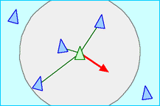
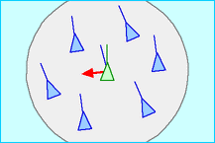
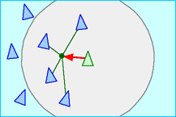
Flocking: 3 Simple Rules
Separation
Alignment
Cohesion

Slide 12
Flocking: 3 Other Rules
Obstacle avoidance
Wandering
Tether
Also, each boid should have random properties (within a small range)
Speed
Acceleration

Slide 13
Tether
If within bounds, Tether has no steering effect.
Global goal is at the center of bounds
Fancier implementation: Periodically move the global goal to a random place within the bounds for variety.
If a Boid goes beyond the Tether bounds, have it (ever-so-slightly) steer toward the Global goal until it is within bounds.

Slide 14
Separation
Alignment
Cohesion
Obstacle Avoidance
Wander
Tether

Slide 15
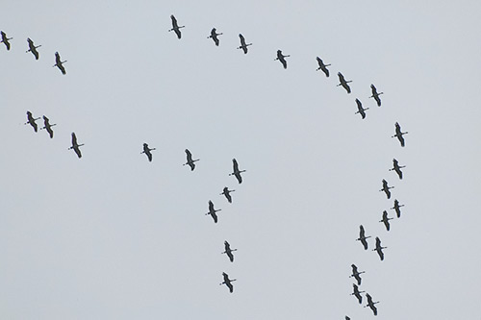
How do you get this?

Slide 16
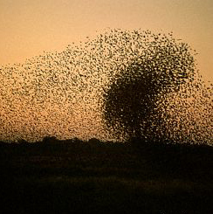
Swarms
Just Cohesion?
Some Alignment?
Any Separation?

Slide 17
Swarm Intelligence
Technique based on collective behavior in decentralized, self-organized systems
Beni & Wang (1989)
Simple agents interact locally
Global behavior emerges
Ant colonies, bird flocking, animal herding
Swarm Robotics
Combining swarm intelligence with robotics

Slide 18
Swarm Intelligence
U.S. military
Swarm techniques for controlling unmanned vehicles
Strategic Defense Initiative (tiny pebbles = satellite-based lasers)
NASA
Swarm technology for planetary mapping
Medical
Kill cancer tumors with swarming nanobots (1992 paper by M. Anthony Lewis and George A. Bekey)
Movies
Flocking in Disney's The Lion King was the first movie to make use of swarm technology (the stampede scene).
Lord of the Rings used emergent behavior during the battle scenes.
Benefits of swarm technology
Cheap, robust, and simple

Slide 19
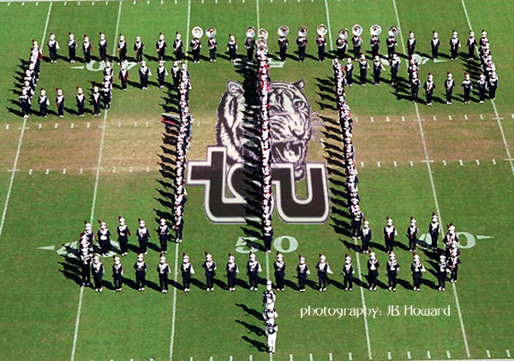
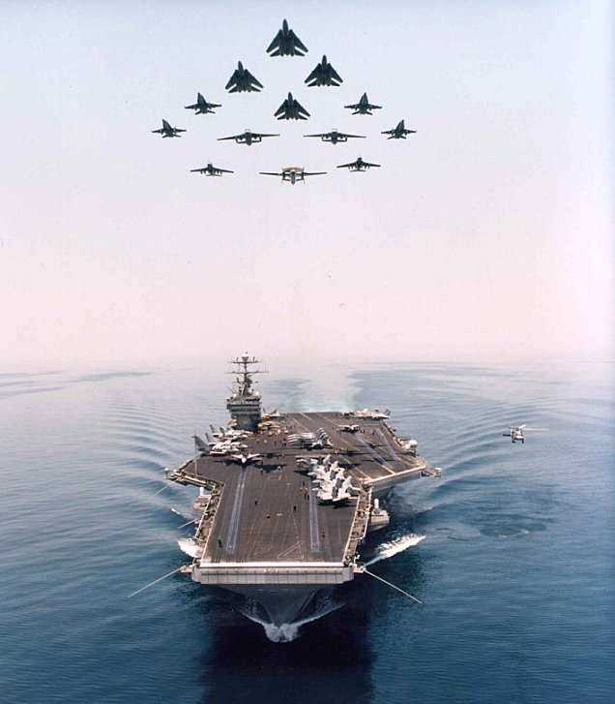
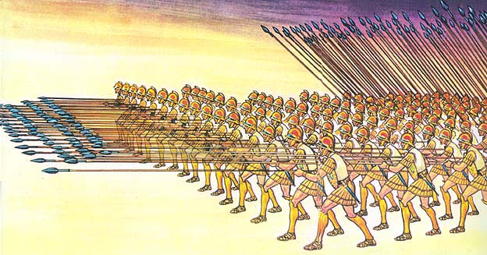
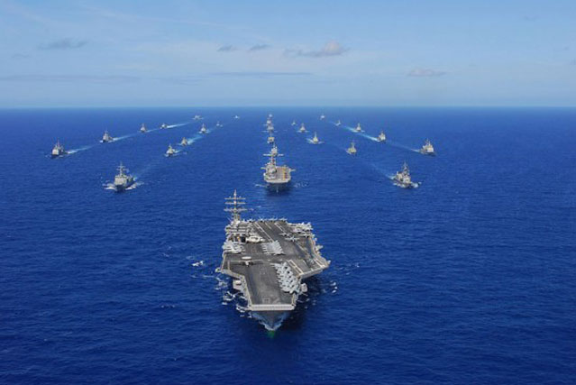
Formations
Mimics military formations
How is it similar to flocking?
How is it different from flocking?

Slide 20
Leader steers
Individuals steer (Arrival to relative offsets)

Slide 21
Lag effect

Slide 22
Lag effect

Slide 23
Lag effect

Slide 24
Lag effect

Slide 25
Lag effect

Slide 26
Template steers
Individuals steer (Arrival to assigned spots)
(no lag effect)
Template
Template

Slide 27
Template

Slide 28
Template

Slide 43
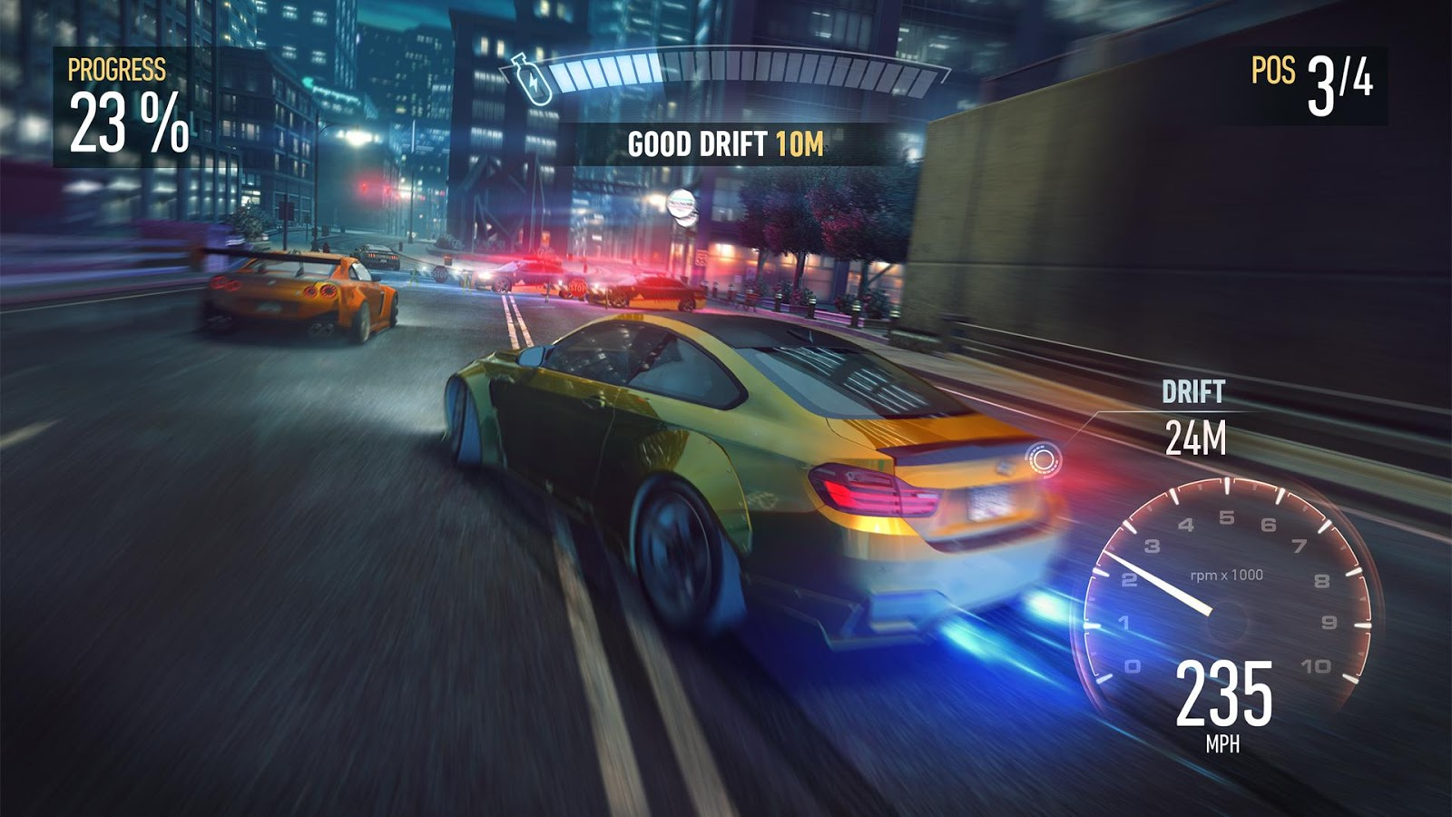
PID Controller for Steering
Proportional-Integral-Derivative
Feedback-based algorithm
50 year old technique
Used in most car racing games to steer cars

Slide 44
PID Controller for Steering
1st term is proportional to the current error
2nd term is proportional to the integral of the error
3rd term is proportional to the derivative of the error

Slide 45
PID Controller for Steering
1st is value of current error
2nd is last several values of the error, multiplied by their time-steps, and all added up
3rd is approximated by taking the current error, subtracting previous error, and dividing by time-step

Slide 46
Questions
Name as many steering behaviors as you can.
Which steering behavior converts uniform randomness into smooth randomness?
What were the steering behavior rules for the follow the leader example? (ducklings version)
Flow fields work best in what kind of environments?
Name as many ways as you can think of to generate the vectors in a flow field.
What does group emergent behavior emerge from?

Slide 47
Flocking
First demonstrated by Craig Reynolds in his 1987 SIGGRAPH paper and movie
“Flocks, Herds, and Schools: A Distributed Behavior Model”
Film: “Stanley and Stella in Breaking the Ice"
1997
Scientific and Technical Award

Slide 48
Boids
“The name had three influences. One was based on a Brooklyn accent, particularly this scene from Mel Brooks' original 1968 film The Producers:”
“You used to be able to sit on the stoop like a normal person, but not any more, ‘cause of da BOIDS. Dirty, lousy, stinkin’ BOIDS.”

Slide 49
Boids
“Another was a very early (~1978?) 3D modeling/rendering system built by Tom Duff (then of the pioneering Graphics Lab of New York Institute of Technology, now at Pixar). The basic modeling primitive of Tom’s system were arbitrary ellipsoids in 3D. He called the system “soids” which I thought was a cool sounding name.”

Slide 50
Boids
“The least fanciful aspect of the name was that the individuals in my flocks were meant to simulate a small part of a real bird’s behavioral repertoire, so they were “bird-like autonomous agents”. I briefly considered calling them bird-oid, but for the two reasons above I quickly slipped into calling them “boids”.”
– Craig Reynolds (personal email May 24, 2013)

Slide 51
Flocking: 3 Simple Rules
Separation
Alignment
Cohesion

Slide 52
Flocking: 3 Other Rules
Obstacle avoidance
Wandering
Tether
Also, each boid should have random properties (within a small range)
Speed
Acceleration

Slide 53
Tether
If within bounds, Tether has no steering effect.
Global goal is at the center of bounds
Fancier implementation: Periodically move the global goal to a random place within the bounds for variety.
If a Boid goes beyond the Tether bounds, have it (ever-so-slightly) steer toward the Global goal until it is within bounds.

Slide 54
Separation
Alignment
Cohesion
Obstacle Avoidance
Wander
Tether

Slide 55
How do you get this?

Slide 56
Swarms
Just Cohesion?
Some Alignment?
Any Separation?

Slide 57
Swarm Intelligence
Technique based on collective behavior in decentralized, self-organized systems
Beni & Wang (1989)
Simple agents interact locally
Global behavior emerges
Ant colonies, bird flocking, animal herding
Swarm Robotics
Combining swarm intelligence with robotics

Slide 58
Swarm Intelligence
U.S. military
Swarm techniques for controlling unmanned vehicles
Strategic Defense Initiative (tiny pebbles = satellite-based lasers)
NASA
Swarm technology for planetary mapping
Medical
Kill cancer tumors with swarming nanobots (1992 paper by M. Anthony Lewis and George A. Bekey)
Movies
Flocking in Disney's The Lion King was the first movie to make use of swarm technology (the stampede scene).
Lord of the Rings used emergent behavior during the battle scenes.
Benefits of swarm technology
Cheap, robust, and simple

Slide 59
Formations
Mimics military formations
How is it similar to flocking?
How is it different from flocking?

Slide 60
Leader steers
Individuals steer (Arrival to relative offsets)

Slide 61
Lag effect

Slide 62
Lag effect

Slide 63
Lag effect

Slide 64
Lag effect

Slide 65
Lag effect

Slide 66
Template steers
Individuals steer (Arrival to assigned spots)
(no lag effect)
Template
Template

Slide 67
Template

Slide 68
Template

Slide 83
PID Controller for Steering
Proportional-Integral-Derivative
Feedback-based algorithm
50 year old technique
Used in most car racing games to steer cars

Slide 84
PID Controller for Steering
1st term is proportional to the current error
2nd term is proportional to the integral of the error
3rd term is proportional to the derivative of the error

Slide 85
PID Controller for Steering
1st is value of current error
2nd is last several values of the error, multiplied by their time-steps, and all added up
3rd is approximated by taking the current error, subtracting previous error, and dividing by time-step

